Slide 1
Children’s Assembly «The Citisen of the XXI Century»
School №40
Team «Siberian Teens»

Slide 2
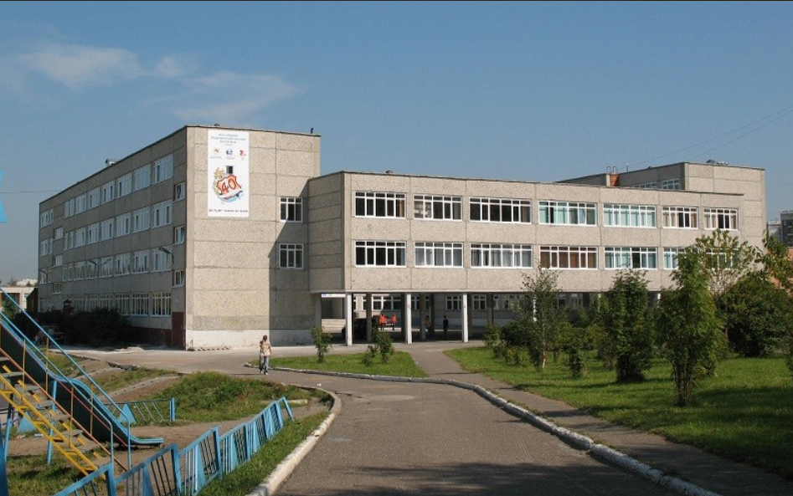
«Siberian Teens»
We are from school № 40.
«Whatever we do we are together.
Being together we can’t be won»

Slide 3
«Siberian Teens»
The man of words and not of deeds,
Is like a garden full of weeds.
(Nursery rhyme)

Slide 4
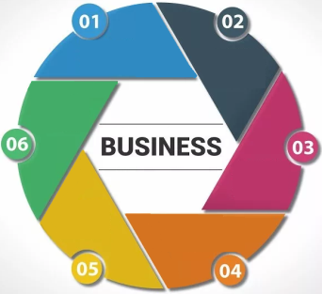
Ethymology of the word «Business»
Old English bisignes (Northumbrian) "care, anxiety, occupation," from bisig "careful, anxious, busy, occupied, diligent“
The original sense is obsolete, as is the Middle English sense of "state of being much occupied or engaged" (mid-14 century), the latter replaced by busyness.
Modern two-syllable pronunciation is 17 century.
Sense of "a person's work, occupation that one does for a livelihood" is first recorded late 14 century. (in late Old English bisig (adj.) appears as a noun with the sense "occupation, state of employment").
Business card first attested in 1840;
Business letter from 1766.
Business end "the practical or effective part" (of something) is American English, by 1874.
Phrase business as usual attested from 1865.
To mean business "be intent on serious action" is from 1856.
To mind (one's) own business "attend to one's affairs and not meddle with those of others" is from 1620s.

Slide 5
The word «дело» in different languages
acuerdo
sprawa
delio
справa
a business
договор
affare
dohoda
affaire
üzlet
sopimus
Deal
tehing
האַנדלען

Slide 6
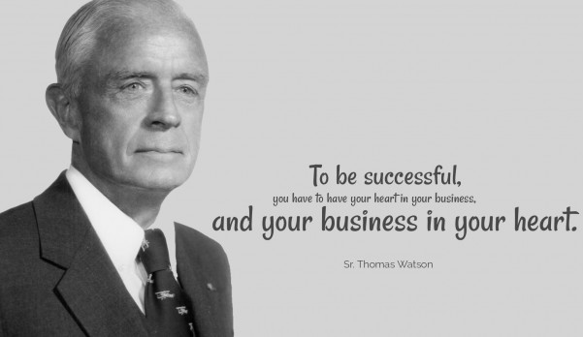
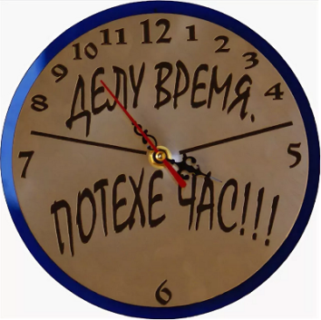
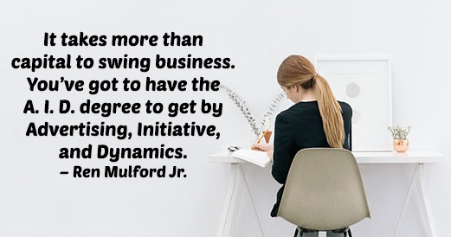
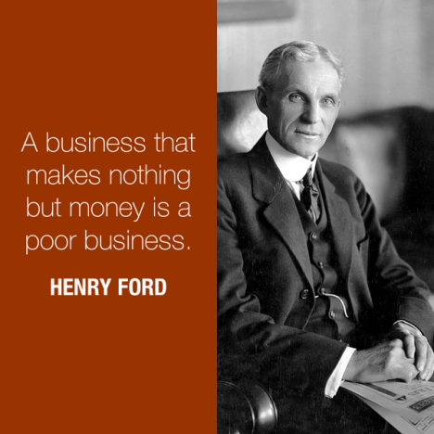
Quotes, sayings, proverbs…

Slide 7
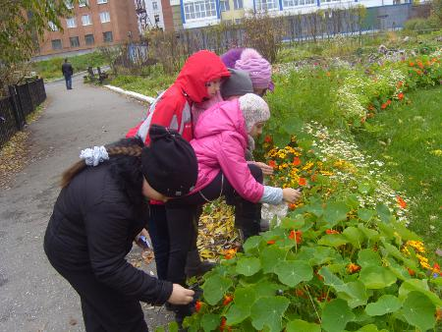
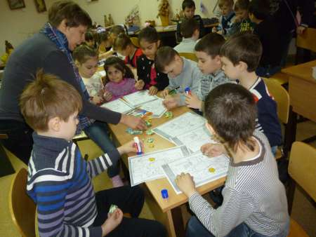
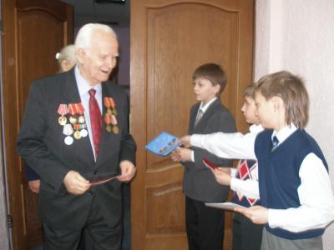
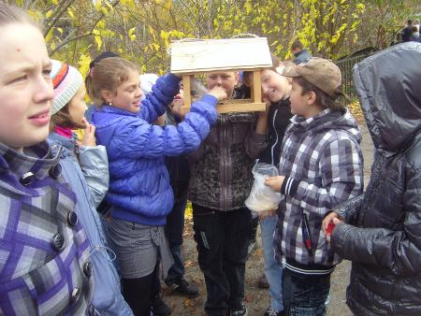
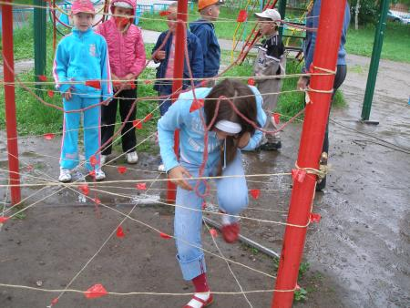
«Siberian Teens»
OUR DEEDS
Plant flowers & trees
Study at school
Help parents and old people
Care about birds & pets
Do sports

Slide 8
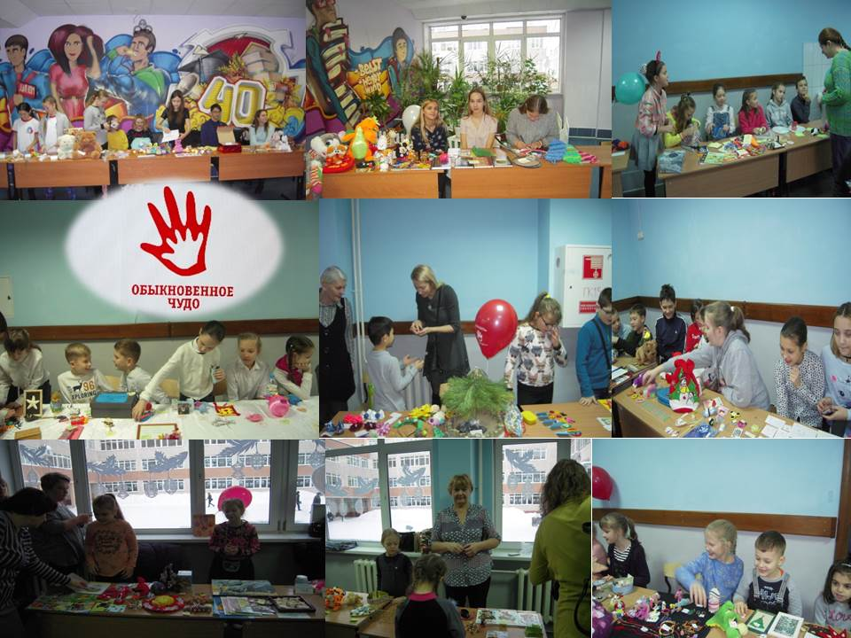
«Siberian Teens»
OUR DEEDS
We participated in Charity Event
«Children for children»

Slide 9
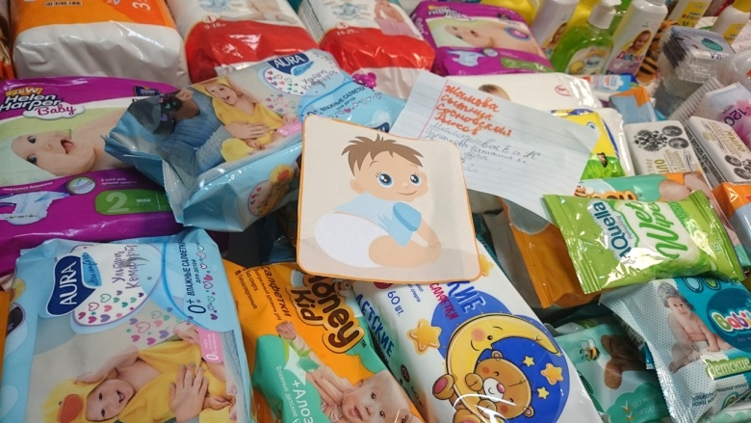
«Siberian Teens»
OUR DEEDS
We brought a lot of diapers, wet wipes and hygiene products for babies to Charity Fund «БлаговестЪ»

Slide 10
«Siberian Teens»
We started to find out what the Business of Life is for each of us and different people.
Business of Life

Slide 11
Investigation
We interviewed the members of our families of different generations.
Our grandparents, moms and dads, brothers and sisters answered the question. There was the question «What is your business of life?»

Slide 12
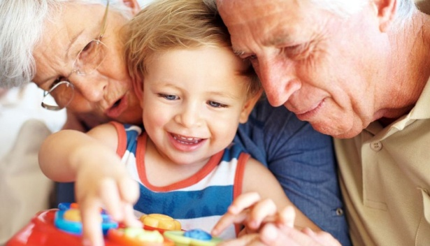
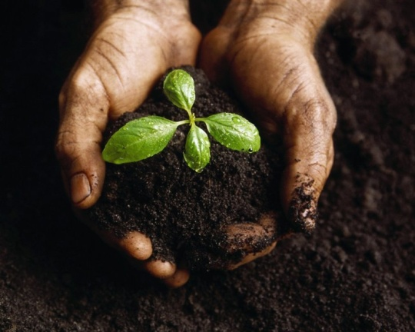
The survey showed the following result:
Grandmothers and grandfathers / grandparents
• to treat people
• to make children and grandchildren happy
• to grow a new generation
• to work well
• to live honestly

Slide 13
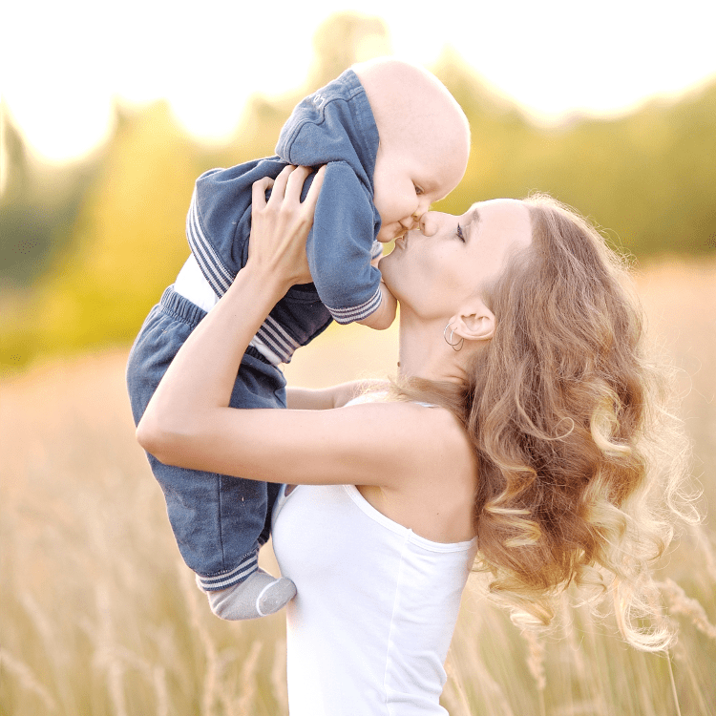
The survey showed the following result:
Moms and Dads / Parents
to be good parents
to bring up children
to do everything for the family needs
to make family happy and united
to do everyone in the family loved each other
to make a family strong and happy
aircraft modeling
to be happy and make happy others
to be useful for people

Slide 14
The survey showed the following result:
Children
to study well
the thing you like to do
the thing which brings you pleasure
the thing which makes you happy
to be successful
to do what you like
to achieve all the goals in the life
football
I do not know

Slide 15
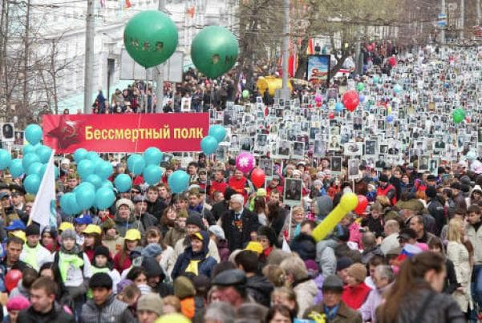
PROJECT
Now we are working on a Project «We keep in our mind & hearts» together with our partners from Bakchar school. The Project is devoted to our relatives killed in GPW. We are going to participate in «Immortal Regiment» event on 9 May.

Slide 16
«Siberian Teens»
We wish you to become friends with us with no matter what our business is!

Slide 17
Thank you for attention!
«Siberian Teens»

